Slide 1
RATHINAM
CENTRE OF EXCELLENCE
Database Management System
Mrs.B.Sharmila
Technical Trainer

Slide 2
Contents
Data
Information
Database
Relational Database
File System Vs DBMS
DBMS
Types Of DBMS
Advantages Of DBMS

Slide 3
Data
Data is a facts that can be recorded.
Data is generally a raw format of any information. It can be in any form like text, number, picture, measurements, and bytes.
Examples : Images, Text, videos etc.
Notes:
For example, student information Ramesh, Chennai, 11, 80.

Slide 4




Data
Rajesh

Slide 5
Information
Information is a processed or meaningful data.
Information refers to data that are processed, organized, structured, and interpreted in a given context, so as to make them useful and meaningful.

Slide 6
Information
Class
Rajesh
City
Marks
Example: Name – Rajesh, City – Chennai, Class – 12, Marks – 80.

Slide 7
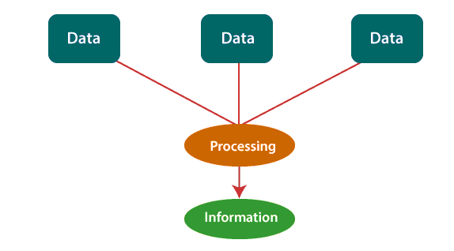
Information

Slide 8

Data and Information

Slide 9

Database
A Database is a logical, consistent and organized collection of related data that it can be easily accessed, managed and updated.
The main purpose of the database is to operate large amount of information by storing ,retrieving and managing data.
Notes:
Example : Youtube is a DB which contains large amount of videos (i.e) Data. Search bar is a query processor which will display the videos based on the query search.

Slide 10
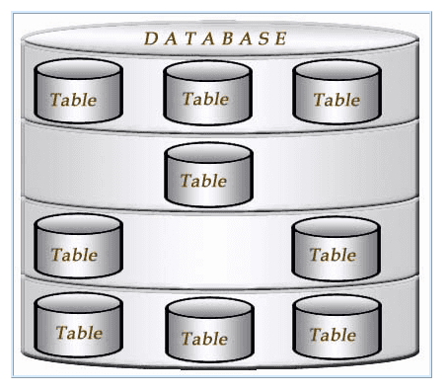
Relational Database
A Relational Database organizes data in to a table-based data structure, with a strict, predefined schema required..
Each table has a column and rows.

Slide 11

File System Vs DBMS
My File
My File – V1
My File – V2
This results in redundancy and inconsistency of data and also results in wastage of storage space.

Slide 12
​ | File System​ | DBMS​
1. Data Redundancy​ | Redundant data can be present in afile system.​ | In DBMS there is no redundant data.​
​ 2. Consistency​ | There is less data consistency in filesystem.​ | There is more data consistency because of the process of normalization.​
3. Query processing​ | There is no efficient query processingin file system.​ | Efficient query processing is there in DBMS.​
​ 4. SecurityConstraints​ | File systems provide less security incomparison to DBMS.​ | DBMS has more security mechanisms as compared to file system.​
5. Backup andRecovery​ | It doesn’tprovide backup andrecovery of data if it islost.​ | It provides backup and recovery of data even if itis lost.​
6. Cost​ | It is less expensive than DBMS.​ | It has a comparatively higher cost than a filesystem.​

Slide 13

Data Base Management System - ​ DBMS​
​

Slide 14
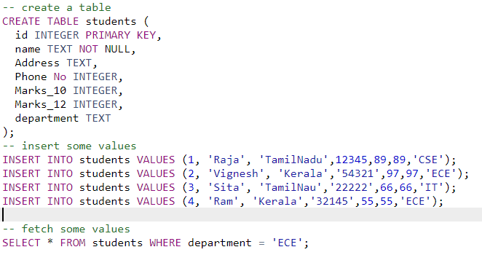
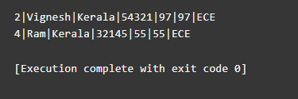
Data Base Management System - ​ DBMS​
​
OUTPUT

Slide 15
Data Base Management System - ​ DBMS​
​
The database management system is a software that allows user to create and maintain a database.
It controls all the different manipulation of data stored or to be stored in a database.
DBMS also provides security and protection to the database.
DBMS acts as a middle layer between the database and the user.

Slide 16
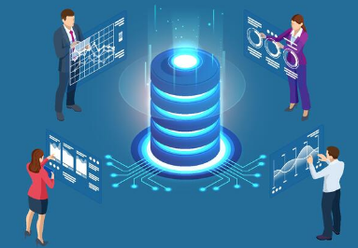
Example - DBMS​
​
Youtube is a DB which contains large amount of videos (i.e) Data. Search bar is a query processor which will display the videos based on the query search.

Slide 17
Types Of​ DBMS​
​
ORACLE MySQL
MS SQL Server
SQL
IBM DB2
Microsoft Access
POSTGRE SQL

Slide 18
Advantages Of DBMS
​
​
​
Data concurrency
Data Searching
Data Integrity
Data Security
Control of Data Redundancy
Data consistency

Slide 19
Database Management System Environment
DBMS - Database + Metadata (Database definition)
Metadata is stored in DBMS catalog
Used By : DBMS Software & Database Users.
DBMS Software must work equally with any number of database applications.

Slide 20
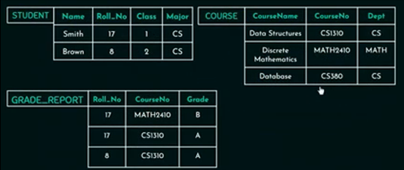
Example Of DBMS Catalog
Database that stores Student Information and Course Details

Slide 21
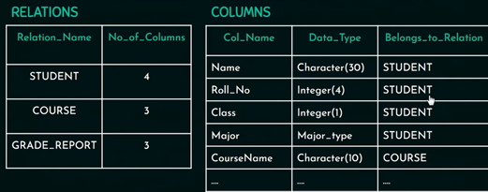
Example Of DBMS Catalog
Example of Database Catalog where Information or description about the Database is stored.

Slide 22
Demo to Show DBMS Catalog
In DBMS, Structure/ Schema of data file is stored in DBMS Catalog separate from the access program providing Program Data Independence.

Slide 23
Views of data - narrates how the data is visualized at each level of Data Abstraction.
Database systems comprise of complex data-structures.​
Data abstraction allow developers to keep complex data structures away from the users.
To make ,​
​the system efficient in terms of retrieval of data.​
reduce complexity in terms of usability of users.​
The developers achieve this by hiding the complex data structures through levels of abstraction.
Views Of Data
Data Abstraction ?
Why Data Abstraction?
Notes:
The characteristics that allows program data independence is called Data Abstractions.

Slide 24
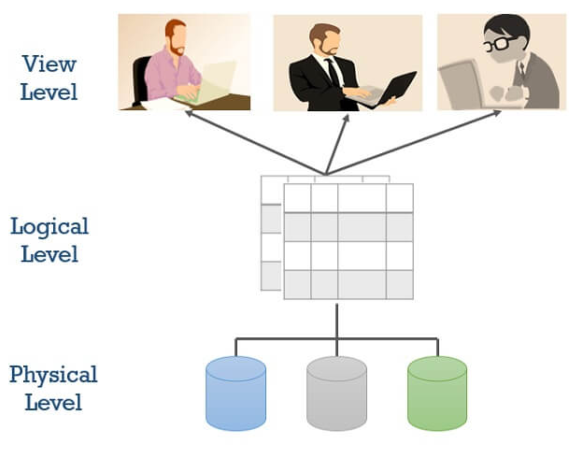
Data Abstraction
There are mainly 3 levels of data abstraction:
Physical level (internal level)​
Logical level (conceptual level)​
View level (external level)​

Slide 25
Physical Level
This is the lowest level of data abstraction.​
The physical or the internal level schema describes how the data is stored and how the data can be accessed. ​
Only the database administrator operates at this level.​

Slide 26
Logical Level
This level comprises of the information that is stored in the database in the form of tables.
Here, the data is stored in the form of the entity set, entities, their data types, the relationship among the entity sets, user operations performed to retrieve or modify the data and certain constraints on the data.​
Adding constraints to the view of data adds the security. As users are restricted to access some particular parts of the database.
​
It is the developer and database administrator who operates at the logical or the conceptual level.​

Slide 27
View Level
This is the highest level of abstraction.​
Only a part of the actual database is viewed by the users. ​
Users view data in the form of rows and columns. Tables and relations are used to store data. Multiple views of the same database may exist.​
Users can just view the data and interact with the database, storage and implementation details are hidden from them.​

Slide 28
Data Independence
The main purpose of data abstraction is achieving data independence in order to save time and cost required when the database is modified or altered.
In Traditional file processing → Structure of data files is embedded in the application programs.
In Database approach → Structure of data files is stored in the DBMS catalog → Separate from access programs (Program – data independence).

Slide 29
Database Architecture
Database architecture focuses on the design, development, implementation and maintenance of computer programs that store and organize information for businesses, agencies and institutions.​
The architecture of a DBMS can be seen as either single tier or multi-tier. The tiers are classified as follows :​
1-tier architecture​
2-tier architecture​
3-tier architecture​
Notes:
https://www.bing.com/videos/search?q=animated+video+fro+DBMS+architecture&&view=detail&mid=24941CC8F6C06090EB7324941CC8F6C06090EB73&&FORM=VRDGAR&ru=%2Fvideos%2Fsearch%3Fq%3Danimated%2520video%2520fro%2520DBMS%2520architecture%26qs%3Dn%26form%3DQBVR%26%3D%2525eManage%2520Your%2520Search%2520History%2525E%26sp%3D-1%26pq%3Danimated%2520video%2520fro%2520dbms%2520architecture%26sc%3D1-36%26sk%3D%26cvid%3D0349CE955C654A83913DBB8E4D643299

Slide 30
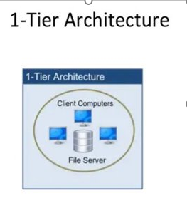
Single tier Architecture
One-tier architecture involves putting all of the required components for a software application or technology on a single server or platform.​
Components such as interface, Middleware, and back-end data, all on one server or platform.​

Slide 31
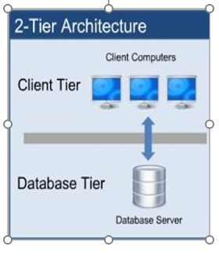
2 - tier Architecture
The two-tier is based on Client Server architecture.​
The direct communication takes place between client and server. There is no intermediate between client and server.​
For this interaction, API's like: ODBC, JDBC are used.​

Slide 32
3 - tier Architecture
It is the most widely used architecture to design a DBMS.​
The 3-Tier architecture contains another layer between the client and server. In this architecture, client can't directly communicate with the server.​
​
The application on the client-end interacts with an application server which further communicates with the database system.​
​
End user has no idea about the existence of the database beyond the application server. The database also has no idea about any other user beyond the application.​

Slide 33
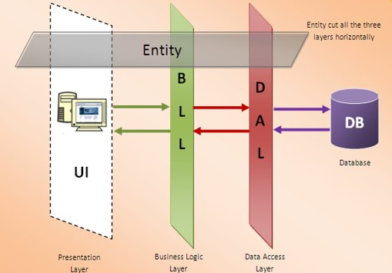
3 - tier Architecture
The 3-Tier architecture is used in case of large web application.​
Database (Data) Tier​
Application (Middle) Tier​
User (Presentation) Tier​

Slide 34
3 - tier Architecture
Database (Data) Tier − At this tier, the database resides along with its query processing languages. We also have the relations that define the data and their constraints at this level.​
Application (Middle) Tier − At this tier reside the application server and the programs that access the database. The application layer sits in the middle and acts as a mediator between the end-user and the database.​
User (Presentation) Tier − End-users operate on this tier and they know nothing about any existence of the database beyond this layer. At this layer, multiple views of the database can be provided by the application. All views are generated by applications that reside in the application tier.​

Slide 35
Database Management System Environment
User / Programs
Application Programs
Software to Process Queries / Program
DBMS Software
Software to Access Stored Data
Store DB Definitions
Stored DataBase

Slide 36
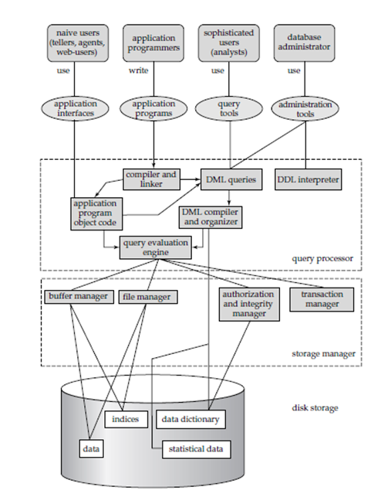

Slide 37
Database Users
Database Users
Database Administrators
Database Designers
Naive
Users
Software Engineers
Structured Query language - SQL

Slide 38
Database Administrators – Database Users
→ In database environment, Primary resources → databae,
Secondary resources → DBMS & related software.
Database Administrator (DBA) responsibilities:
Administering primary/ secondary resources.
Authorizing access to the database.
Coordinating & monitoring use of database.
Acquiring hardware & Software resources as needs.
Structured Query language - SQL
Notes:
Whenever a user submits a query, the database checks against the granted privileges and rejects the query if it is not authorized.

Slide 39
Database Designers – Database Users
Responsible for:
Identifying the data to be stored in the database.
Choosing appropriate structures to represent the stored data.
Communicating with database users → understand their requirements →designs database.
Structured Query language - SQL

Slide 40
End Users – Database Users
End User → people whose jobs require access to the database → for quering , updating ,generating reports.
Structured Query language - SQL

Slide 41
Software Engineers – Database Users
Software Engineers:
System Analysts → Determine the requirements of end users → develop specification for end users.
Application Programmers → Test ,debug, document and maintain the requirements of end users.
Structured Query language - SQL

Slide 42
Query Processor
The query processor will accept query from user and solves it by accessing the database.
Parts of Query processor:
DDL interpreter
This will interprets DDL statements and fetch the definitions in the data dictionary.
DML compiler
This will translates DML statements in a query language into low level instructions that the query evaluation engine understands.
A query can usually be translated into any of a number of alternative evaluation plans for same query result DML compiler will select best plan for query optimization.
Query evaluation engine
This engine will execute low-level instructions generated by the DML compiler on DBMS.

Slide 43
Storage Manager
Storage Manager/Storage Management:
A storage manager is a program module which acts like interface between the data stored in a database and the application programs and queries submitted to the system.
Thus, the storage manager is responsible for storing, retrieving and updating data in the database.
The storage manager components include:
Authorization and integrity manager: Checks for integrity constraints and authority of users to access data.
Transaction manager: Ensures that the database remains in a consistent state although there are system failures.
File manager: Manages the allocation of space on disk storage and the data structures used to represent information stored on disk.
Buffer manager: It is responsible for retrieving data from disk storage into main memory. It enables the database to handle data sizes that are much larger than the size of main memory.

Slide 44
Storage Manager
Data structures implemented by storage manager.
Data files: Stored in the database itself.
Data dictionary: Stores metadata about the structure of the database.
Indices: Provide fast access to data items.

Slide 45
Disadvantages Of DBMS
​
​
​
Cost of DBMS
Huge Size
Performance
Complexity
Cost Of data conversion
Database failure

Slide 46
Thank You!​
​

